Slide 1

MATLAB & Its Practical Concepts

Slide 2
Outlines For Session-I
What is Matlab?
Uses of Matlab
Environment
Naming Rule
Basic Operator
Variables
Datatypes
Data Conversion
Decision Statements
Looping Structures
Vectors, Matrix and Array
Inbuilt constant
Function Making

Slide 3
Session-I

Slide 4
What is Matlab?
The name MATLAB stands for matrix laboratory.
MATLAB was originally written to provide easy access to matrix software developed by the LINPACK and EISPACK projects, which together represent the state-of-the-art in software for matrix computation.
MATLAB® is a programming platform designed specifically for engineers and scientists to analyze and design systems and products that transform our world. The heart of MATLAB is the MATLAB language, a matrix-based language allowing the most natural expression of computational mathematics.

Slide 5
Continue.
What Can I Do With MATLAB?
Analyze data
Develop algorithms
Create models and applications
Millions of engineers and scientists worldwide use MATLAB for a range of applications, in industry and academia, including deep learning and machine learning, signal processing and communications, image and video processing, control systems, test and measurement, computational finance, and computational biology.

Slide 6
Uses Of Matlab
MATLAB is a high-performance language for technical computing. It integrates computation, visualization, and programming in an easy-to-use environment where problems and solutions are expressed in familiar mathematical notation.
Typical uses include:
Math and computation
Algorithm development
Modeling, simulation, and prototyping
Data analysis, exploration, and visualization
Scientific and engineering graphics
Application development, including Graphical User Interface building

Slide 7
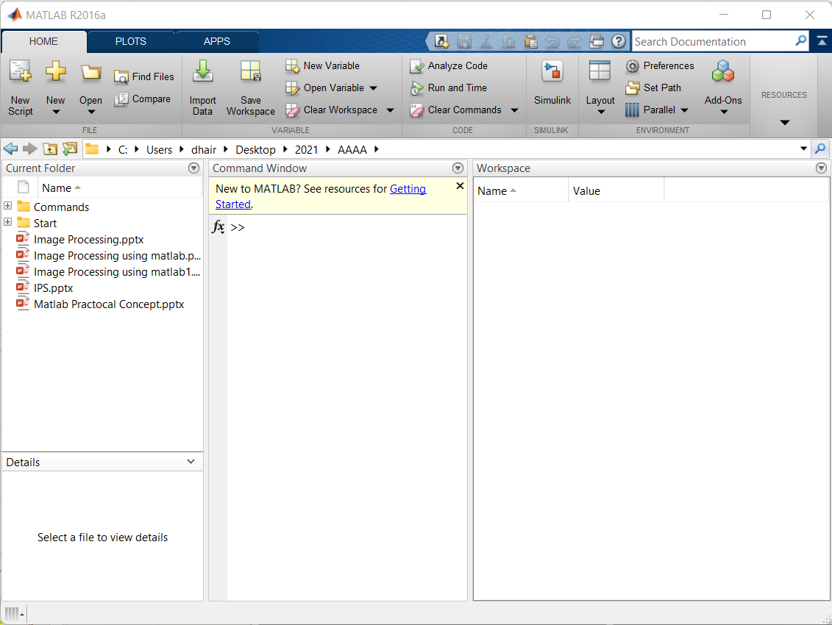
Environment
MATLAB window components:
File Path
Add Path of Code Folder
Workspace
Displays all the defined variables
Command Window
To execute commands in the MATLAB environment
Current Directory
View Folder and m-files
File Path
Command Window
Current Directory
Workspace

Slide 8
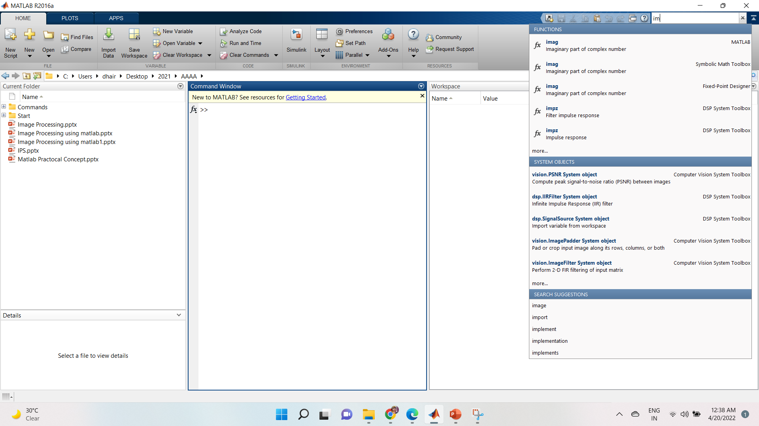
Matlab Help
MATLAB Help is an extremely powerful assistance to learning MATLAB
Help not only contains the theoretical background, but also shows demos for implementation
MATLAB Help can be opened by using the HELP pull-down menu
Help Search

Slide 9
Naming Rule
Variable naming rules
must be unique in the first 63 characters
must begin with a letter
may not contain blank spaces or other types of punctuation
may contain any combination of letters, digits, and underscores
are case-sensitive
should not use Matlab keyword
Pre-defined variable names
pi

Slide 10
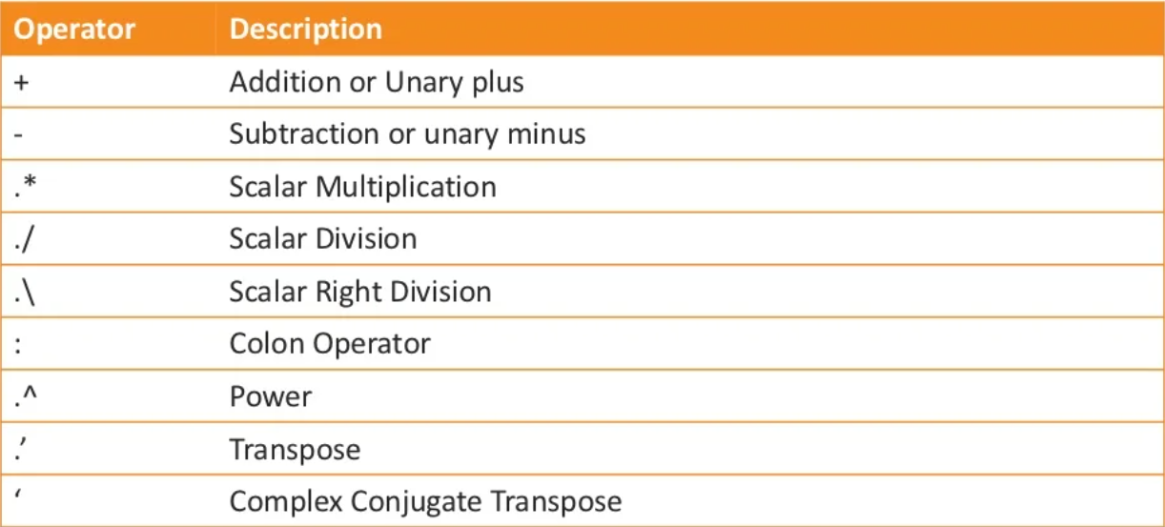
Basic Operator

Slide 11
Practice
A=10
B= 20
C= A+B
D=A-B
E=A*B
F=A/B
G=1:10
H=10^2

Slide 12
Variables
Matlab Does not require any type declaration or dimension statement
Matlab uses conventional decimal notation, scientific notation latter e to specify power of ten scale factor.
Matlab store all numbers internally using the long format specific by the IEEE floating point standard.
Once a variable is entered into the system, you can refer to it later.
Variables must have values before they are used.
When an expression returns a result that is not assigned to any variable, the system assigns it to a variable named ans, which can be used later.

Slide 13
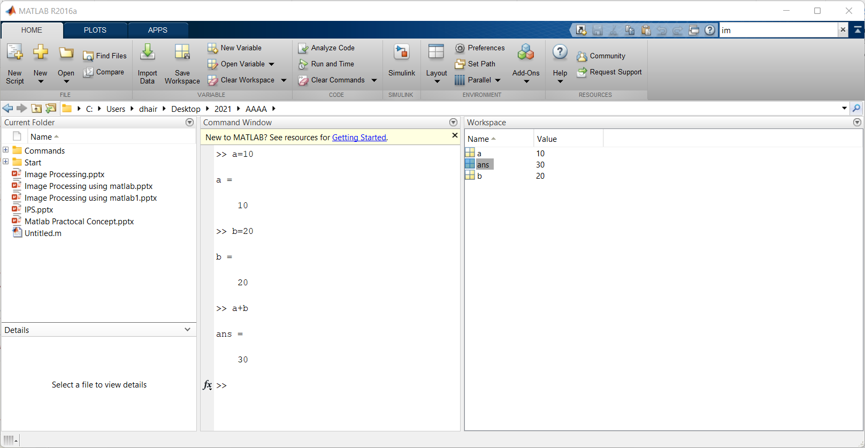
Practice

Slide 14
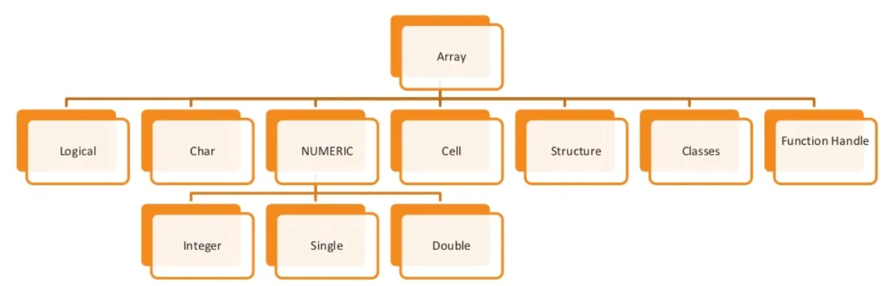
Datatypes

Slide 15
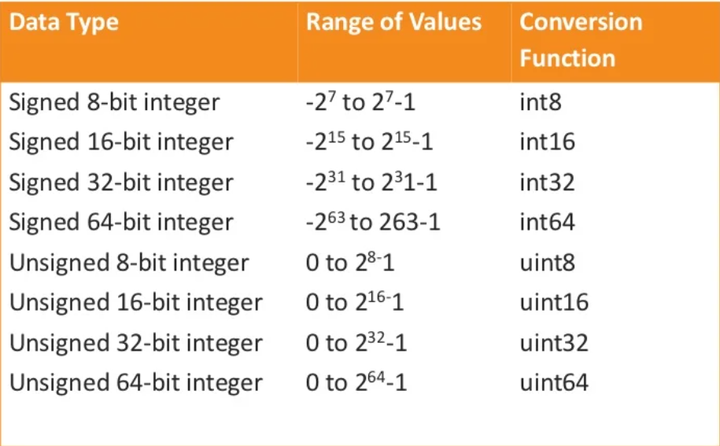
Continue.

Slide 16
Datatype Conversion
Function | Purpose
char | Convert to character array (string)
int2str | Convert integer data to string
mat2str | Convert matrix to string
num2str | Convert number to string
str2double | Convert string to double-precision value
str2num | Convert string to number
native2unicode | Convert numeric bytes to Unicode characters
unicode2native | Convert Unicode characters to numeric bytes
base2dec | Convert base N number string to decimal number
bin2dec | Convert binary number string to decimal number
dec2base | Convert decimal to base N number in string
dec2bin | Convert decimal to binary number in string
dec2hex | Convert decimal to hexadecimal number in string
hex2dec | Convert hexadecimal number string to decimal number
hex2num | Convert hexadecimal number string to double-precision number
num2hex | Convert singles and doubles to IEEE hexadecimal strings
cell2mat | Convert cell array to numeric array
cell2struct | Convert cell array to structure array
cellstr | Create cell array of strings from character array
mat2cell | Convert array to cell array with potentially different sized cells
num2cell | Convert array to cell array with consistently sized cells
struct2cell | Convert structure to cell array

Slide 17
Practice
%Convert the array to character
A = [77 65 84 76 65 66];
C = char(A)
%Convert the array to string
B = ['Past','Present','Future']
D = cellstr(B)
%Convert the value int to string
chr = int2str(256)
%Convert the value matrix to string
chr1 = mat2str([3.85 2.91; 7.74 8.99])
%Convert the value number to string
S = num2str(pi)
%Convert the value string to double
X = str2num('100')
%Convert the value string to double
Y = str2double('3.1416')
%Convert the value base to decimal
baseStr = '1B';
D1 = base2dec(baseStr,12)
%Convert the value to a decimal to base number.
D2 = 23;
baseStr = dec2base(D2,12)
%Convert a character vector that represents a hexadecimal value to a decimal number.
hexStr = '3FF';
D3 = hex2dec(hexStr)

Slide 18
Determine Data Type
Function | Purpose
is | Detect state
isa | Determine if input is object of specified class
iscell | Determine whether input is cell array
iscellstr | Determine whether input is cell array of strings
ischar | Determine whether item is character array
isfield | Determine whether input is structure array field
isfloat | Determine if input is floating-point array
ishghandle | True for Handle Graphics object handles
isinteger | Determine if input is integer array
isjava | Determine if input is Java object
islogical | Determine if input is logical array
isnumeric | Determine if input is numeric array
isobject | Determine if input is MATLAB object
isreal | Check if input is real array
isscalar | Determine whether input is scalar
isstr | Determine whether input is character array
isstruct | Determine whether input is structure array
isvector | Determine whether input is vector
class | Determine class of object
validateattributes | Check validity of array
whos | List variables in workspace, with sizes and types

Slide 19
Practice
x = 3
isinteger(x)
isfloat(x)
isvector(x)
isscalar(x)
isnumeric(x)
x = 23.54
isinteger(x)
isfloat(x)
isvector(x)
isscalar(x)
isnumeric(x)
x = [1 2 3]
isinteger(x)
isfloat(x)
isvector(x)
isscalar(x)
x = 'Hello'
isinteger(x)
isfloat(x)
isvector(x)
isscalar(x)
isnumeric(x)

Slide 20
Initial Command
To clear Window – clc
To closed all fig- close all
To clear work space area- clear all

Slide 21
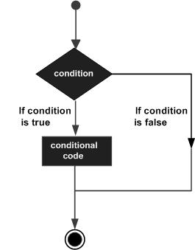
Decision Statements
Decision making structures require that the programmer should specify one or more conditions to be evaluated or tested by the program, along with a statement or statements to be executed if the condition is determined to be true, and optionally, other statements to be executed if the condition is determined to be false.

Slide 22
If --end
Create a script file and type the following code −
a = 10;
% check the condition using if statement
if a < 20
% if condition is true then print the following
fprintf('a is less than 20\n' );
end
fprintf('value of a is : %d\n', a);
When you run the file, it displays the following result −
a is less than 20
value of a is : 10

Slide 23
If-else-end
Create a script file and type the following code −
a = 100;
% check the boolean condition
if a < 20
% if condition is true then print the following
fprintf('a is less than 20\n' );
else
% if condition is false then print the following
fprintf('a is not less than 20\n' );
end
fprintf('value of a is : %d\n', a);
When the above code is compiled and executed, it produces the following result −
a is not less than 20
value of a is : 100

Slide 24
If--elseif-elseif-end
Create a script file and type the following code in it −
a = 100;
%check the boolean condition
if a == 10
% if condition is true then print the following
fprintf('Value of a is 10\n' );
elseif( a == 20 )
% if else if condition is true
fprintf('Value of a is 20\n' );
elseif a == 30
% if else if condition is true
fprintf('Value of a is 30\n' );
else
% if none of the conditions is true '
fprintf('None of the values are matching\n');
fprintf('Exact value of a is: %d\n', a );
end
When the above code is compiled and executed, it produces the following result−
None of the values are matching
Exact value of a is: 100

Slide 25
Nested if
Create a script file and type the following code in it −
a = 100;
b = 200;
% check the boolean condition
if( a == 100 )
% if condition is true then check the following
if( b == 200 )
% if condition is true then print the following
fprintf('Value of a is 100 and b is 200\n' );
end
end
fprintf('Exact value of a is : %d\n', a );
fprintf('Exact value of b is : %d\n', b );
When you run the file, it displays −
Value of a is 100 and b is 200
Exact value of a is : 100
Exact value of b is : 200

Slide 26
Switch
grade = 'B';
switch(grade)
case 'A'
fprintf('Excellent!\n' );
case 'B'
fprintf('Well done\n' );
case 'C'
fprintf('Well done\n' );
case 'D'
fprintf('You passed\n' );
case 'F'
fprintf('Better try again\n' );
otherwise
fprintf('Invalid grade\n' );
end
When you run the file, it displays −
Well done

Slide 27
Nested Switch
a = 100;
b = 200;
switch(a)
case 100
fprintf('This is part of outer switch %d\n', a );
switch(b)
case 200
fprintf('This is part of inner switch %d\n', a );
end
end
fprintf('Exact value of a is : %d\n', a );
fprintf('Exact value of b is : %d\n', b );
When you run the file, it displays −
This is part of outer switch 100
This is part of inner switch 100
Exact value of a is : 100
Exact value of b is : 200

Slide 28
Looping Structures
for a = 10:20
fprintf('value of a: %d\n', a);
end
When you run the file, it displays the following result −
value of a: 10
value of a: 11
value of a: 12
value of a: 13
value of a: 14
value of a: 15
value of a: 16
value of a: 17
value of a: 18
value of a: 19
value of a: 20

Slide 29
Interval loop
for a = 1.0: -0.1: 0.0
disp(a)
end
When you run the file, it displays the following result −
1
0.90000
0.80000
0.70000
0.60000
0.50000
0.40000
0.30000
0.20000
0.10000
0

Slide 30
Custom Loop
for a = [24,18,17,23,28]
disp(a)
end
When you run the file, it displays the following result −
24
18
17
23
28

Slide 31
Array
All variables of all data types in MATLAB are multidimensional arrays. A vector is a one-dimensional array and a matrix is a two-dimensional array.
We have already discussed vectors and matrices. In this chapter, we will discuss multidimensional arrays. However, before that, let us discuss some special types of arrays.

Slide 32
Special Arrays in MATLAB
zeros(5)
MATLAB will execute the above statement and return the following result −
ans =
0 0 0 0 0
0 0 0 0 0
0 0 0 0 0
0 0 0 0 0
0 0 0 0 0

Slide 33
Continue.
ones(4,3)
MATLAB will execute the above statement and return the following result −
ans =
1 1 1
1 1 1
1 1 1
1 1 1

Slide 34
Continue.
eye(4)
MATLAB will execute the above statement and return the following result −
ans =
1 0 0 0
0 1 0 0
0 0 1 0
0 0 0 1

Slide 35
Continue
rand(3, 5)
MATLAB will execute the above statement and return the following result −
ans =
0.8147 0.9134 0.2785 0.9649 0.9572
0.9058 0.6324 0.5469 0.1576 0.4854
0.1270 0.0975 0.9575 0.9706 0.8003

Slide 36
A Magic Square
A magic square is a square that produces the same sum, when its elements are added row-wise, column-wise or diagonally.
magic(4)
MATLAB will execute the above statement and return the following result −
ans =
16 2 3 13
5 11 10 8
9 7 6 12
4 14 15 1

Slide 37
Multidimensional Arrays
An array having more than two dimensions is called a multidimensional array in MATLAB. Multidimensional arrays in MATLAB are an extension of the normal two-dimensional matrix.
a = [7 9 5; 6 1 9; 4 3 2]
MATLAB will execute the above statement and return the following result −
a =
7 9 5
6 1 9
4 3 2

Slide 38
Inbuilt Comand
Function | Purpose
length | Length of vector or largest array dimension
ndims | Number of array dimensions
size | Array dimensions
diag | Diagonal matrices and diagonals of matrix
flipdim | Flips array along specified dimension
fliplr | Flips matrix from left to right
flipud | Flips matrix up to down
repmat | Replicates and tile array
reshape | Reshapes array
rot90 | Rotates matrix 90 degrees
sort | Sorts array elements in ascending or descending order
sortrows | Sorts rows in ascending order
transpose | Transpose

Slide 39
Function Making
Both scripts and functions allow you to reuse sequences of commands by storing them in program files. Scripts are the simplest type of program, since they store commands exactly as you would type them at the command line. Functions provide more flexibility, primarily because you can pass input values and return output values. For example, this function named fact computes the factorial of a number (n) and returns the result (f).
function f = fact(n)
f = prod(1:n);
end

Slide 40
Primary and Sub-Functions
function [x1,x2] = quadratic(a,b,c)
%this function returns the roots of
% a quadratic equation.
% It takes 3 input arguments
% which are the co-efficients of x2, x and the
%constant term
% It returns the roots
d = disc(a,b,c);
x1 = (-b + d) / (2*a);
x2 = (-b - d) / (2*a);
end % end of quadratic
function dis = disc(a,b,c)
%function calculates the discriminant
dis = sqrt(b^2 - 4*a*c);
end % end of sub-function

Slide 41
Nested Function
function [x1,x2] = quadratic2(a,b,c)
function disc % nested function
d = sqrt(b^2 - 4*a*c);
end % end of function disc
disc;
x1 = (-b + d) / (2*a);
x2 = (-b - d) / (2*a);
end % end of function quadratic2
You can call the above function from command prompt as ?
quadratic2(2,4,-4)

Slide 42
Outlines For Session-II
What is Image?
Types of Image
Basic Function
Arithmetical Operation
Color Conversion Model
Histogram Equalization
Thresholding Function
Filtering Function
Morphological Function
Edge Detection
Future Research Direction

Slide 43
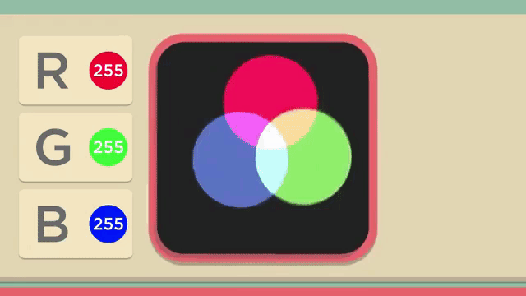
Session-II

Slide 44

What is Image?
A Image is a Set of Pixel(Picture Elements) .
We can think of an image as a function, f, from R² to R:
f( x, y ) gives the intensity at position ( x, y )
The image can now be represented as a matrix of integer values

Slide 45
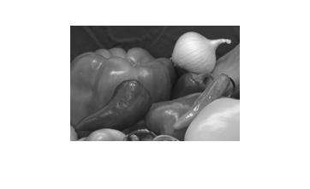

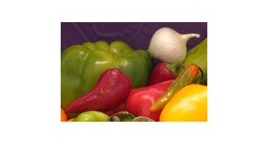
Types of Image (2D)
Image
Black/White
Gray Scale
Color (RGB)
Red Component:0 to 255
Green Component:0to 255
Blue Component:0to255
Black White Image Pixel Value:
For, Black:0
White:1
0 to 255 Pixel Intensity
Intensity means amount of Brightness
Brightness means “Source of Light”

Slide 46
Formats of Image
Tiff
(Tagged Image File Format)
Tiff is Not Compression Image
Png
(Portable Network Graphics)
Png is Lossless Image Compression
Image Formats
Jpeg/jpg
(Joint Graphics Expert Group)
Jpeg is Lossy Image Compression
Bmp
Bitmap Format
Bmp is Not Image Compression
Gif
(Graphic Interchange Format)
Gif is Lossless Image Compression

Slide 47
Key Stages in Digital Image Processing
Image Restoration
Morphological Processing
Image Enhancement
Segmentation
Image Acquisition
Object Recognition
Representation & Description
Problem Domain
Colour Image Processing
Image Compression

Slide 48

Key Stages in Digital Image Processing: Image Aquisition
Image Restoration
Morphological Processing
Image Enhancement
Segmentation
Image Acquisition
Object Recognition
Representation & Description
Problem Domain
Colour Image Processing
Image Compression

Slide 49
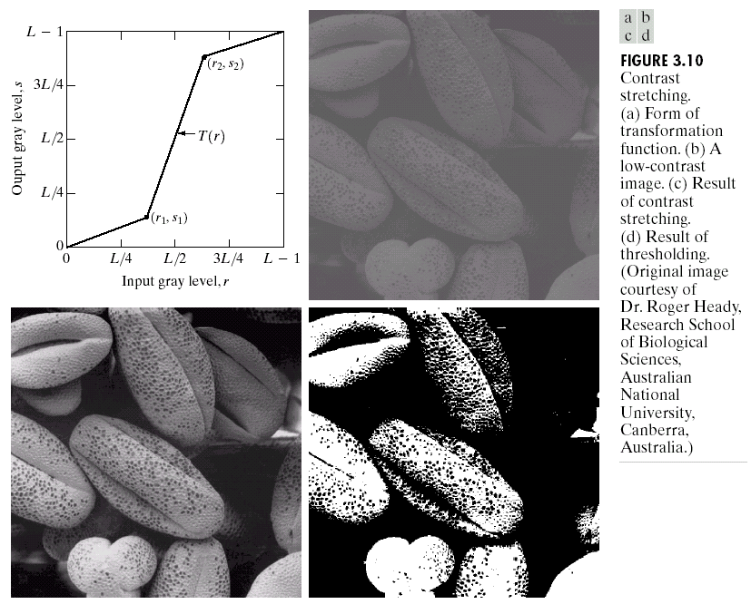
Key Stages in Digital Image Processing: Image Enhancement
Image Restoration
Morphological Processing
Image Enhancement
Segmentation
Image Acquisition
Object Recognition
Representation & Description
Problem Domain
Colour Image Processing
Image Compression

Slide 50
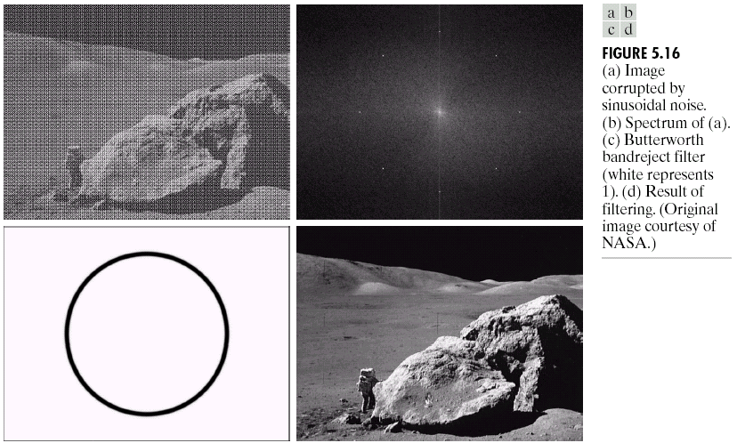
Key Stages in Digital Image Processing: Image Restoration
Image Restoration
Morphological Processing
Image Enhancement
Segmentation
Image Acquisition
Object Recognition
Representation & Description
Problem Domain
Colour Image Processing
Image Compression

Slide 51
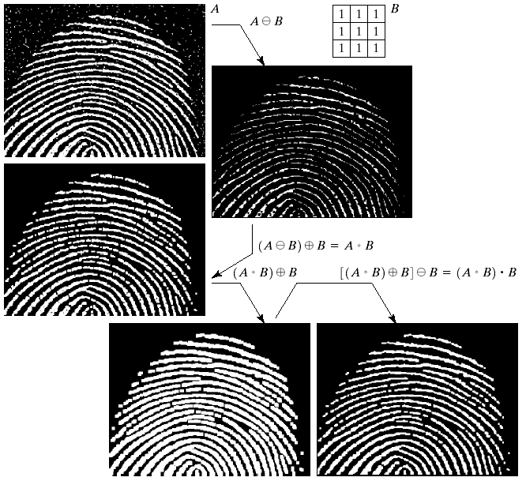
Key Stages in Digital Image Processing: Morphological Processing
Image Restoration
Morphological Processing
Image Enhancement
Segmentation
Image Acquisition
Object Recognition
Representation & Description
Problem Domain
Colour Image Processing
Image Compression

Slide 52
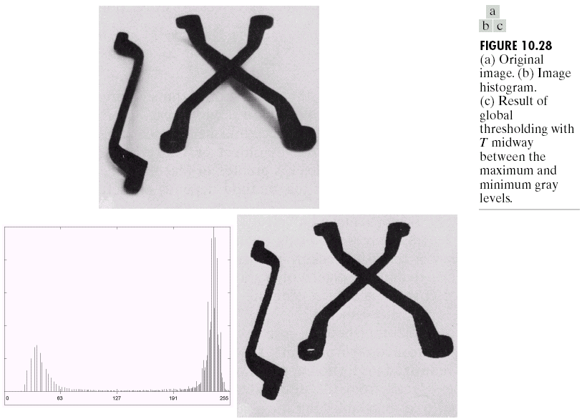
Key Stages in Digital Image Processing: Segmentation
Image Restoration
Morphological Processing
Image Enhancement
Segmentation
Image Acquisition
Object Recognition
Representation & Description
Problem Domain
Colour Image Processing
Image Compression

Slide 53
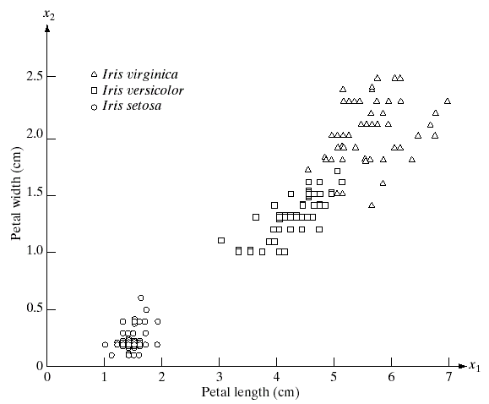
Key Stages in Digital Image Processing: Object Recognition
Image Restoration
Morphological Processing
Image Enhancement
Segmentation
Image Acquisition
Object Recognition
Representation & Description
Problem Domain
Colour Image Processing
Image Compression

Slide 54
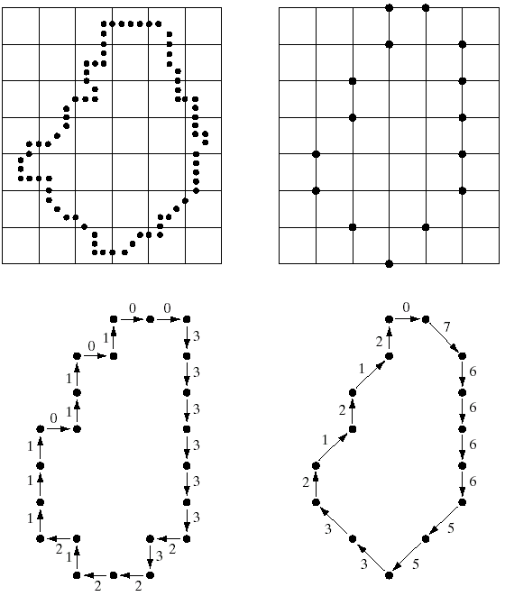
Key Stages in Digital Image Processing: Representation & Description
Image Restoration
Morphological Processing
Image Enhancement
Segmentation
Image Acquisition
Object Recognition
Representation & Description
Problem Domain
Colour Image Processing
Image Compression

Slide 55
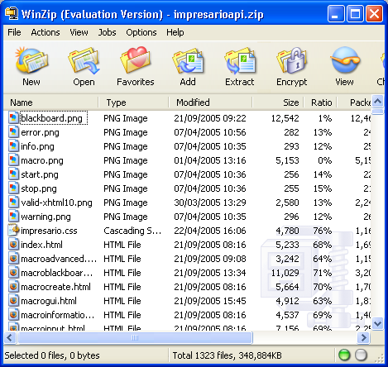
Key Stages in Digital Image Processing: Image Compression
Image Restoration
Morphological Processing
Image Enhancement
Segmentation
Image Acquisition
Object Recognition
Representation & Description
Problem Domain
Colour Image Processing
Image Compression

Slide 56
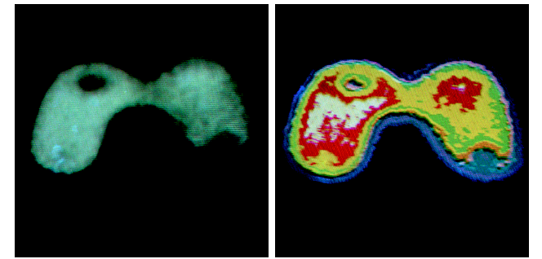
Key Stages in Digital Image Processing: Colour Image Processing
Image Restoration
Morphological Processing
Image Enhancement
Segmentation
Image Acquisition
Object Recognition
Representation & Description
Problem Domain
Colour Image Processing
Image Compression

Slide 57
Basic Function
Imread()
Imshow()
Resize()
Imwrire()
Rgb2gray()
Figure()
Subplot()
Title()

Slide 58
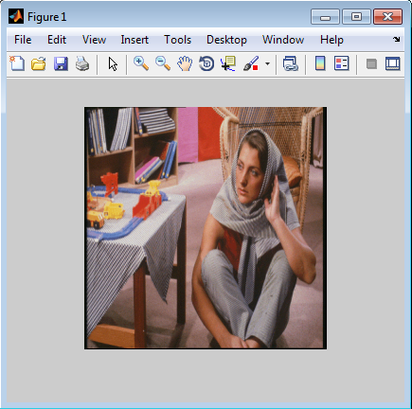
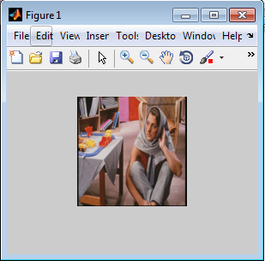
Basic Function
Change the Size of Image
I=imresize(img,[row col])
i=imread('barbara.png'); imshow(i);
j=imresize(i,0.5); imshow(j);

Slide 59
Basic Function
Conversion of Image
RGB to Gray scale Conversion
d=rgb2gray(a);
figure; imshow(d);
Separate Three Component from RGB Image
r=c(:,:,1);
g=c(:,:,2);
b=c(:,:,3);
>>I % ctrl+c to halt output!

Slide 60
RGB to GrayScale Without Command
clc;
clear all;
close all;
c=imread ('onion.png');
r=c(:,:,1);
g=c(:,:,2);
b=c(:,:,3);
e = .299*r + .587*g + .114*b;
d1=rgb2gray(c);
figure('Name','Original');
imshow(c);
figure('Name','Red');
imshow(r);
figure('Name','Green');
imshow(g);
figure('Name','Blue');
imshow(b);
figure('Name','gray manual');
imshow(e);
figure('Name','Gray by Inbuild');
imshow(d1);

Slide 61
Subplot Command
Subplot: To arrange multiple images into single figure.
Subplot(row,column,position);
Title: To give Title to particular image.
Title(‘Title of Image’);

Slide 62
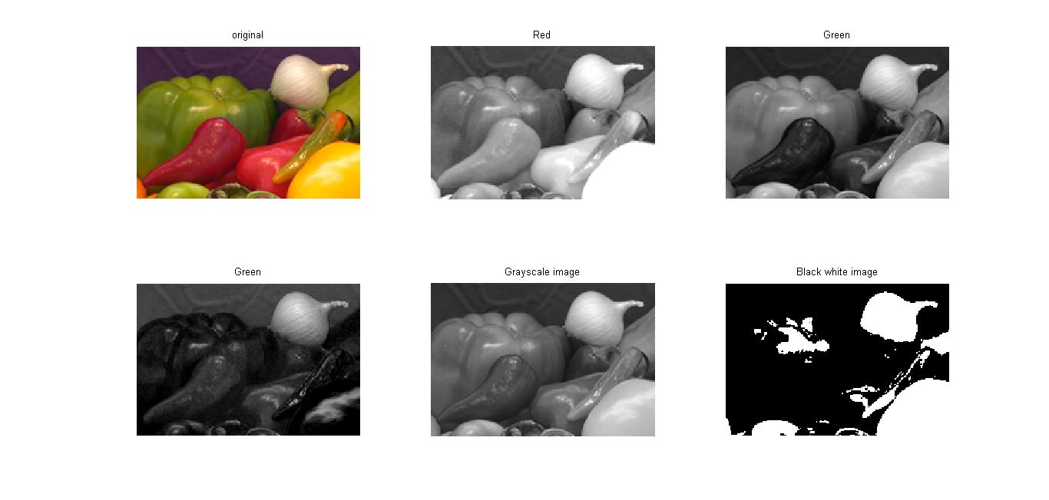
Subplot

Slide 63
Example of Subplot
clc;
clear all;
close all;
c=imread ('onion.png');
r=c(:,:,1);
g=c(:,:,2);
b=c(:,:,3);
d1=rgb2gray(c);
d2=im2bw(c);
subplot(2,3,1); imshow(c); title('original');
subplot(2,3,2); imshow(r);title('Red');
subplot(2,3,3); imshow(g);title('Green');
subplot(2,3,4); imshow(b);title(‘Blue');
subplot(2,3,5); imshow(d1); title('Grayscale image');
subplot(2,3,6); imshow(d2);title('Black white image');

Slide 64
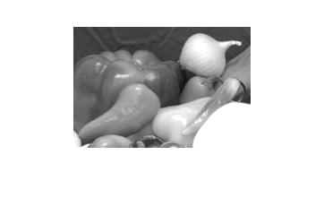
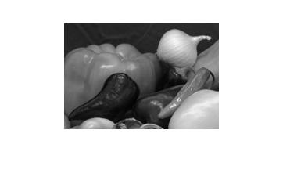
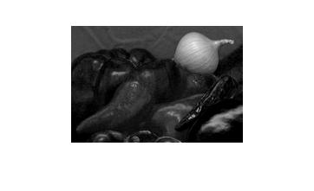
Convert R-G-B Component to RGB
clc;
clear all;
close all; R Component
c=imread ('onion.png');
r=c(:,:,1);
g=c(:,:,2);
b=c(:,:,3);
fin(:,:,1)=r; G Component B Component
fin(:,:,2)=g;
fin(:,:,3)=b;
figure; imshow(fin);

Slide 65
Basic Function
Size: To Find size of image.
[q w e]=size(c);
q=row
W=col
e= dimension
imresize: To Change size of image.
d1=imresize(c,[64 64]);
imshow(d1);
d2=imresize(c,1/4);
imshow(d2);

Slide 66
Basic Function
imcrop: To crop the image.
d3=imcrop(c);
imshow(d3);
as=imcrop(c,[25 35 50 65]);
imshow(as);
Imwrite: To store the image.
imwrite(as,'1.jpg');
imrotate: To rotate the image.
d4=imrotate(c,270);
imshow(d4);

Slide 67
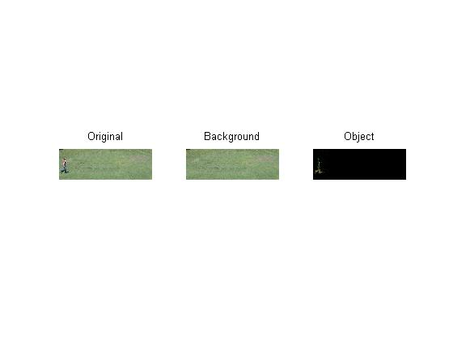
Arithmetic Operation on Image
imsubtract:
To subtract one image from second image.
Application: Background Subtraction(Removal)

Slide 68
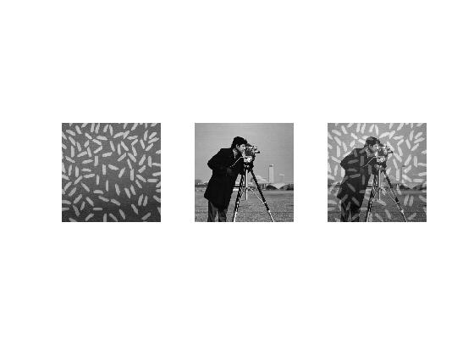
To add two image(imadd)
clc
close all
clear all
I = imread('rice.png');
J = imread('cameraman.tif');
K = imadd(J,I,'uint16');
subplot(131);
imshow(I);
subplot(132);
imshow(J);
subplot(133);
imshow(K,[]);

Slide 69
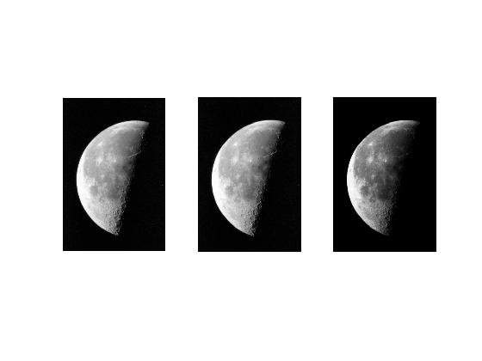
To Multiply two image(immultiply)
clc
close all
clear all
I = imread('moon.tif');
I16 = uint16(I);
J = immultiply(I16,I16);
subplot(131);
imshow(I);
subplot(132);
imshow(I16,[]);
subplot(133);
imshow(J);

Slide 70
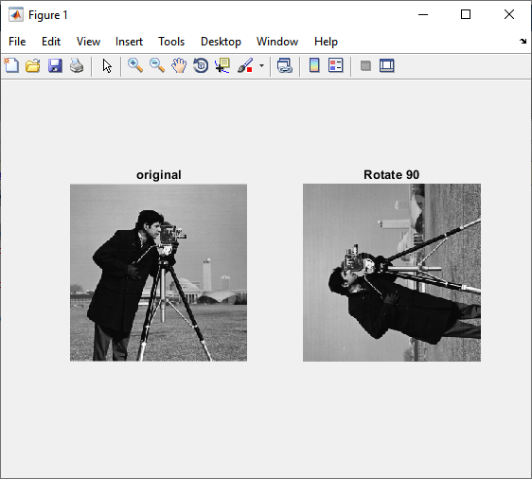
Rotation
B = imrotate(A,angle) rotates image A by angle degrees in a counterclockwise direction around its center point. To rotate the image clockwise, specify a negative value for angle.
img=imread('cameraman.tif');
rt=imrotate(img,90);
subplot(1,2,1);imshow(img);title('original');
subplot(1,2,2);imshow(rt);title('Rotate 90');

Slide 71
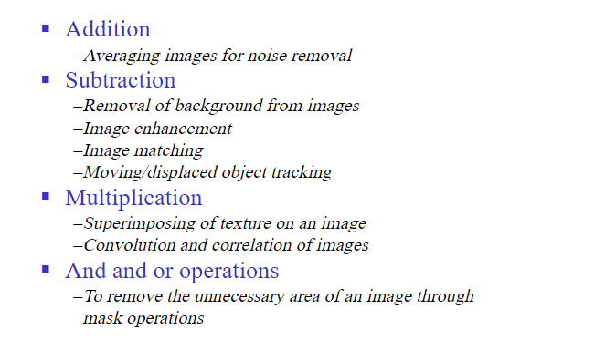
Application of Arithmetic Operation

Slide 72
Thank You

